Slide 1


Critical Writing
MSc Paramedic Practice
Learning Development Centre
Kim Williams
Academic Development Tutor

Slide 2
Overall Learning Objective
By the end of today’s session we will be able to demonstrate our understanding of how to write critically

Slide 3

Being critical?
What does it mean?

Slide 4

Critical Thinking…
The first question a critical thinker SHOULD ask is…
WHY?!
What research exists that suggests this would benefit us in any way?
What research exists that suggests that this would NOT benefit us?
ALSO
How VALID is this research anyway?
GO TO BED
AT 10PM

Slide 5
Descriptive writing vs critical writing
Focus should be on the arguments you want to present in response to the assessment task, rather than a description of the topic.
Descriptive writing is of course still necessary to:
•set the scene
•provide background information, evidence or context for your critical arguments
•give signposts to your reader.
Keep to a minimum!

Slide 6
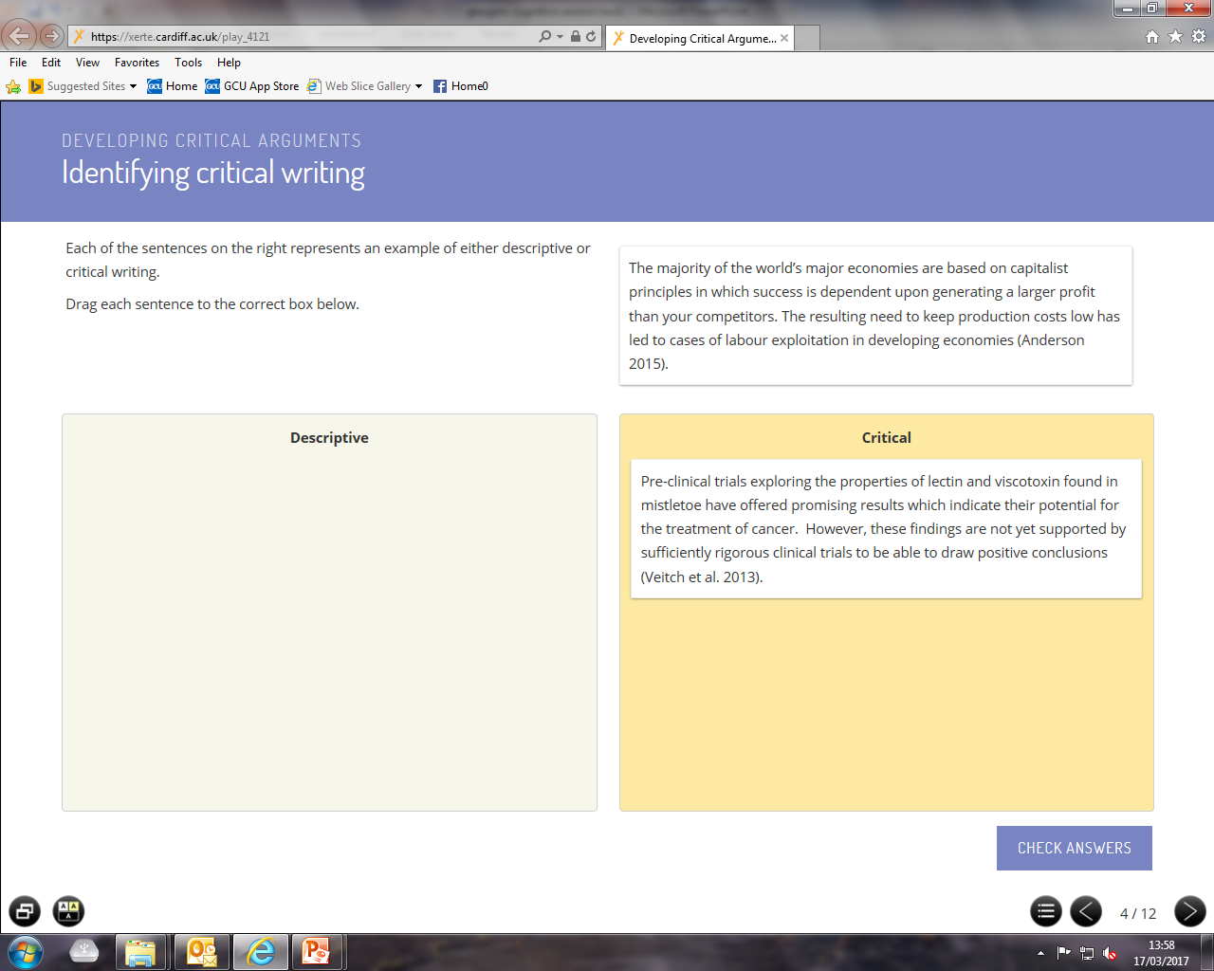
Task: critical or descriptive?
Critical

Slide 7
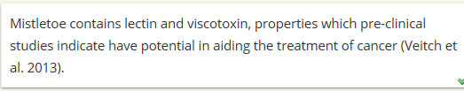
Task: critical or descriptive?
Descriptive

Slide 8
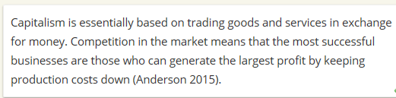
Task: critical or descriptive?
Descriptive

Slide 9
Critical Analysis
Let’s look now at the difference between descriptive writing and critical writing in a bit more detail.
Which one of these is a more effective paragraph and why?

Slide 10
Activity 1
EXEMPLAR 2
A study by Daniels (2002) found that group exercise was more effective than a control (n=24) in significantly reducing anxiety symptoms among 28 middle-aged men. The participants were randomly assigned to groups and effects were maintained at 6 month follow-up. A strength of Daniel’s study was the randomisation of participants to groups and the incorporation of a follow-up anxiety measure. This is a strength because . . . (ref). However, the study is limited due to the relatively small sample size and anxiety measure which has been shown to have poor reliability (ref). This presents problems regarding . . .
EXEMPLAR 1
A study by Daniels (1998) found that group exercise was more effective than a control (n=21) in significantly reducing anxiety symptoms among 22 middle-aged men. The participants were randomly assigned to groups and effects were maintained at 6 month follow-up.

Slide 11

Critical thinking is…
Asking the ‘whys’ and ‘hows’, not just the ‘whats’
This means being analytical, not just descriptive. So you need to:
  Give examples
  Give explanations
  Draw comparisons
  Consider alternative approaches or explanations
  Discuss strengths and weaknesses
  Make links with practice
  Using evidence

Slide 12

Critical vs. Descriptive writing
  Descriptive writing tells you the ‘what’ the critical tells you the ‘why’
  Critical writing shows an awareness of a body of knowledge and your thoughts on this backed up with evidence
Useful resource http://www.phrasebank.manchester.ac.uk/being-critical/

Slide 13
Critiquing…
The TOPIC itself
e.g. Critically evaluate breast-feeding
You could look at:
Strengths of breast feeding
Limitations of breast feeding
Compare and contrast findings on this…
ALWAYS DRAWING FROM QUALITY LITERATURE
2) The RESEARCH PAPER
You should also critique the PAPERS/STUDIES themselves
You could look at:
The methods used
The number of participants
The questions asked
Conclusions drawn
Was the researched peer-reviewed etc.

Slide 14




Critical thought should begin…
Contextual info – could use for intro.
Method
Results
Strengths
Weaknesses
Contextual info – could use for intro.
Method
Results
Strengths
Weaknesses
Contextual info – could use for intro.
Method
Results
Strengths
Weaknesses
…from the minute you start reading!

Slide 15
Organising your findings
Authors | Topic/Practice / Product etc. | For what purpose? | Strengths | Weaknesses | Practice implications
Pelli, Robson and Wilkins (1998) | Hair thickening shampoo to be used across all branches of X hairdressers | To increase thickness and volume of hair. | Majority of participants (80%) found that hair became shinier and more manageable after use | It appeared to have little affect on thickness with only 5% of participants noting an improvement in thickness of hair | An additional product may need to be sourced by hairdressers to enhance thickness.
This is a generic table – you may wish to personalise yours for this specific review.

Slide 16
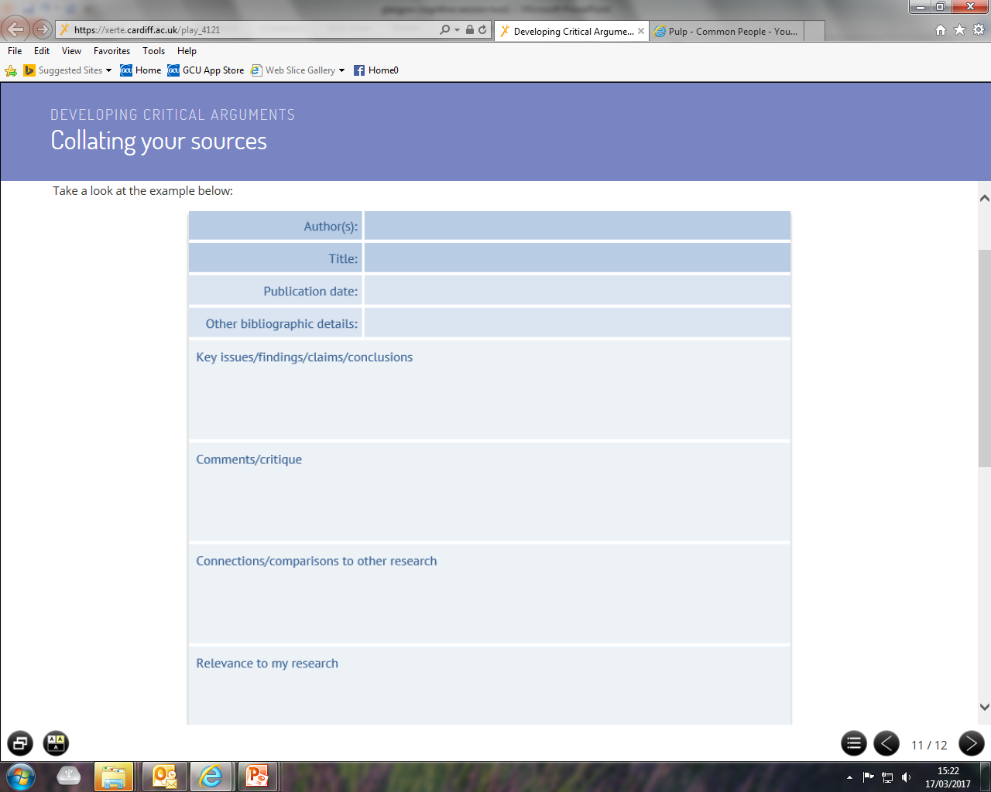

Slide 17

Academic writing- example*
Food refusal is a major problem that has evolved, so nutritionists have adopted an approach of setting up home visits to support families with their child's eating problems. "Sure Start" centres have been set up also by the Nutrition Society for mothers to be educated on basic food issues. Technological advances have also aided the role of nutritionists. Computerised nutrient analysis helps to calculate nutrient intake in relation to the statistical data. In addition to this, anthropologists have tried to find distinct separation between the food as a biological necessity and also the cultural factors that condition its availability and consumption. In essence they are looking at the same preface as nutritionists however with a varied priority. Where as nutritionists seem to focus on nutrient intake of the big five in relation to achieving a healthy human diet, anthropologists assess lifestyle changes and finding the right diet and nutrient intake to suit
*References above are entirely fictitious and used for illustrative purposes only
(Marked By Teachers, 2017)
Entirely descriptive- not critical
No clear line of thought – topic sentence doesn’t work effectively with what is contained in paragraph
No evidence of wider reading (no references)

Slide 18
Academic writing- example*
Food refusal is a major problem that has evolved in children (Smith, 2016) so significant research has been undertaken by nutritionists to understand and ultimately address this issue (topic sentence). Jones (2017) found that technological advances facilitating computerised nutrient analysis have aided nutritionists in calculating nutrient intake in relation to the statistical data linked to food refusal (description). Jones found that a key strength of computerised nutrient analysis is…. (strength). A recent study by Wilson (2017), however, highlighted that … (limitation). Additionally, nutritionists have adopted an approach of setting up home visits to support families with their child's eating problems (Scott, 2013). ‘Sure Start’ centres have been set up by the Nutrition Society (2015) for parents to be educated on basic food issues (description). ‘Sure Start’ centres were found to be beneficial in… (strength). In addition to this, Martin (2017) also found that a key strength of such centres is… It has been suggested, however, that while these centres can offer a wide range of benefits to parents dealing with food refusal they are limited in …(limitation).
References are entirely fictitious and used for illustrative purposes only (Marked By Teachers, 2017)
Topic sentence relevant to paragraph content
Synthesis
Critical analysis
Accurate references and academic tone

Slide 19
Initial Assessment
Problem
Methodology
Participants
Conclusions
Data Analysis/Results
Critiquing Literature

Slide 20
Initial Assessment
The year it was published – has new evidence been added to the literature since this publication?
Also note that seminal papers may have been published a significant time ago and, although the studies are old, these may still be of significance to modern practice.
Is there evidence of a peer review process? This would suggest robustness to the content and indicate a reduced likelihood of publication of poor quality research.
Also consider authors’ declarations of interest and potential market bias.
Example: Recent years have seen the publication of a number of critiques of changes in funding regimes, for example: Anderson (2003); Phillips (2002). However this text was published before the recent wave of reforms took place. Consequently, although much of the journal’s contents remain valuable, the conclusions on this particular aspect of the problem are at best partial in nature, and at worst no longer relevant.

Slide 21
Problem
The study must address a significant or relevant problem and usually provide new or meaningful results.
The current literature should also have been reviewed and commonly will support the hypothesis, which should be clearly stated.

Slide 22
Methodology
Several types of study design are available and each has their advantages and disadvantages. An inappropriate study design can incorporate bias into the study and subsequently skew results.
Example, Horowitz (1969) interviewed a smaller sample (n = 31) of individuals said to be representative members of a drug-taking community, found that 32% (that is 8 individuals) reported having flashbacks. However there was poly-drug use amongst this group, which could have confounded the results.

Slide 23
Participants
To minimise any bias within an study the sample population should be representative of the population being studied as a whole and, ideally, participants should be allocated randomly within the study.
It is also imperative to consider the sample size in the study and identify if the study is adequately powered to produce statistically significant results

Slide 24
Conclusions
The authors should also address shortcomings in the study and discuss how this may have affected the results and recommendations proposed.
Example: The main shortcoming of this text is the author’s reliance on personal opinion rather than empirical data. For example, on page 325 there is a critical attack on the government’s policy towards private eye hospitals, but the author offers no data to support the argument he is making. In the absence of any supporting evidence there is no way of judging the validity or reliability of his conclusions and this seriously undermines the value of the work.

Slide 25
Justifying your strengths and weaknesses
It will add strength to your analysis if you are able to JUSTIFY your assertion of a study’s strength or weakness by including evidence, such as an expert’s argument/theory. For example, if you were suggesting the weakness was in methodology you may wish to add:
Gibb (2015) found that there is evidence to suggest that it should not be assumed that the individuals in a focus group are expressing their own definitive individual view.

Slide 26
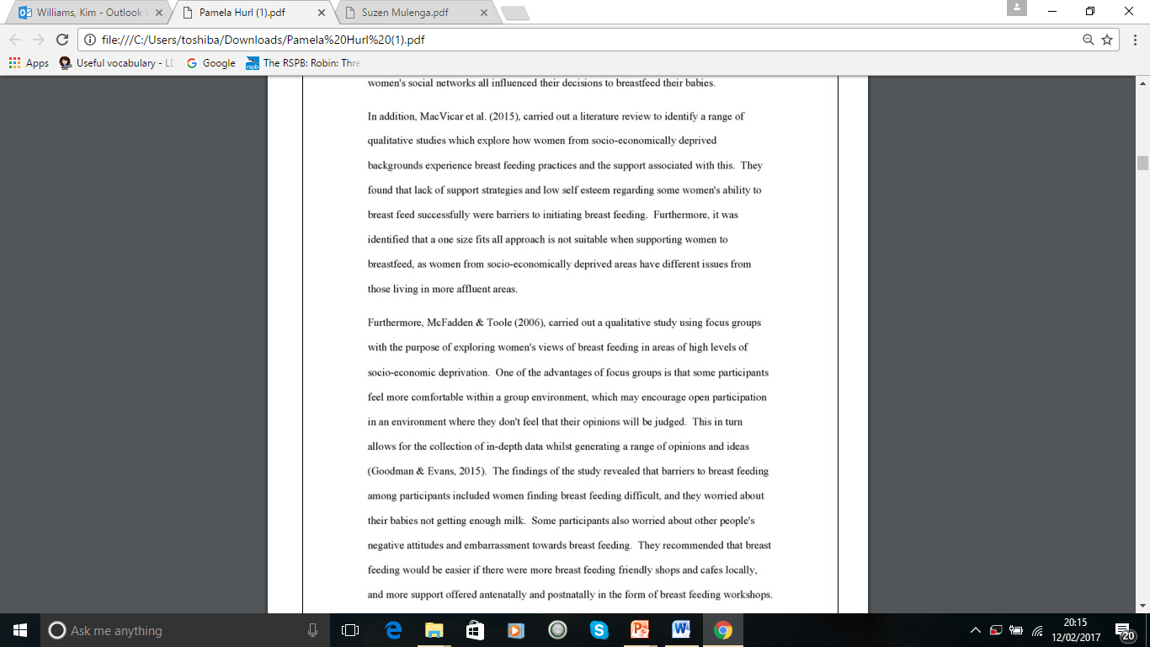
Accurate referencing
Academic tone throughout
In addition/ furthermore – links studies
Critique of research paper/methods
Limitations of breast feeding stated

Slide 27
For additional support one to one support on academic writing you can:
Book an appointment with an ADT on https://sites.google.com/site/ldcgculearn/
Come along to our ‘drop-in session’ on Wednesdays 2-4pm
Kim Williams
Academic Development Tutor
Learning Development Centre
Govan Mbeki Building – A107

